Slide 1
A SURVEY OF DEEP ACTIVE LEARNING(link)

Slide 2
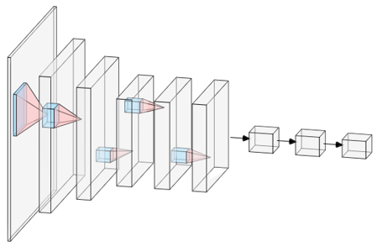
What is Deep Learning
Subfield of machine learning
Attempts to build appropriate
Structure Diagram of Convolutional Neural network
Notes:
Deep Learning is a subfield of machine learning concerned with algorithms inspired by the structure and function of the brain called artificial neural networks. It attempts to build appropriate models by simulating the structure of the human brain.

Slide 3
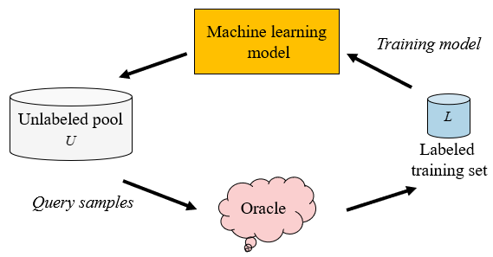
Active Learning
Active Learning is just a method.
Hands over most useful samples from unlabeled dataset to the oracle (e.g., human annotator) for labeling
Reduces the cost of labeling
Pool based Active Learning cycle
Notes:
Active Learning is just a method. It aims to select the most useful samples from the unlabeled dataset and hand it over to the oracle (e.g., human annotator) for labeling, to reduce the cost of labeling as much as possible while still maintaining performance.
The figure above explains the pool-based AL cycle: Use the query strategy to query the sample in the unlabeled pool U and hand it over to the oracle for labeling, then add the queried sample to the labeled training dataset L and train, and then use the newly learned knowledge for the next round of querying. Repeat this process until the label budget is exhausted or the pre-defined termination conditions are reached.

Slide 4
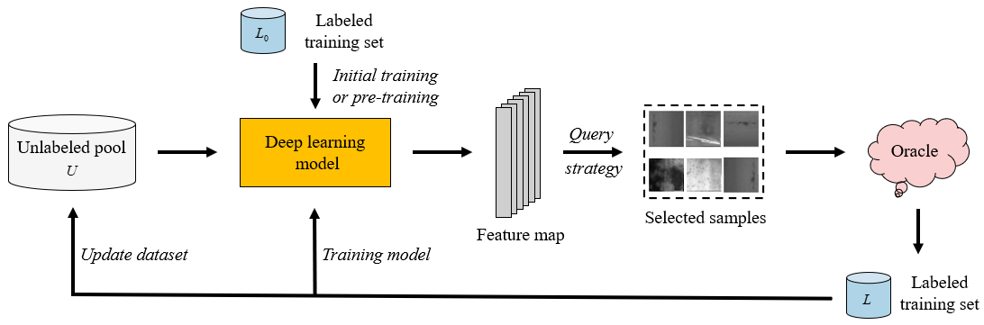
Deep Active Learning
A typical example of DAL
Notes:
A typical example of DAL: The parameters θ of the DL model are initialized or pre-trained on the label training set L0, and the samples of the unlabeled pool U are used to extract features through the DL model. Then samples are selected based on the corresponding query strategy and the label is queried to form a new label training set L. Later DL model is trained on L, and U is updated at the same time. This process is repeated until the label budget is exhausted or the pre-defined termination conditions are reached.

Slide 5
Difficulties in applying AL into DL
Insufficient data for label samples: AL often relies on a small amount of labeled sample data to learn and update the model, while DL is often very greedy for data
Model uncertainty: In classification tasks, DL uses the SoftMax layer for output. It is unreliable as a measure of confidence, and the performance of this method will thus be even worse than that of random sampling
Processing pipeline inconsistency: Most AL algorithms focus primarily on the training of classifiers, and the various query strategies utilized are largely based on fixed feature representations. In DL, however, feature learning and classifier training are jointly optimized.

Slide 6
Approaches to overcome difficulties in applying AL to DL
To address the Insufficient data problem, researchers have considered using generative networks for data augmentation or assigning pseudo-labels to high-confidence samples to expand the labeled training set.
To solve the neglect of model uncertainty in DL, some researchers have applied Bayesian deep learning to deal with the high-dimensional mini- batch samples with fewer queries in the AL context.
To deal with the pipeline inconsistency problem, researchers have considered modifying the combined framework of AL and DL to make the proposed DAL model as general as possible

Slide 7
Query Strategy Optimization in DAL
Batch Mode DAL (BMDAL): The main difference between DAL and classic AL is that DAL uses batch-based sample querying.
Uncertainty-based and hybrid query strategies: This approach is simple in form and has low computational complexity and hence a very popular query strategy in AL.
Deep Bayesian Active Learning (DBAL) : DBAL combines Bayesian convolutional neural networks (BCNNs) with AL methods to adapt BALD to the deep learning environment.
Density-based Methods: The term, density-based method, mainly refers to the selection of samples from the perspective of the set (core set).

Slide 8
Common DAL Frameworks
Cost-Effective Active Learning (CEAL): CEAL merges deep convolutional neural networks into AL, and consequently proposes a novel DAL framework
A Deep Active Learning Framework for Biomedical Image Segmentation: Offers a framework that uses a fully convolutional network (FCN) and AL to solve the medical image segmentation problem using a small number of annotations
Active Palmprint Recognition: Proposes a similar DAL framework as that for the palmprint recognition task inspired by domain adaptation,
Learning Loss for Active Learning (LLAL): Designs a small parameter module of the loss prediction module to attach to the target network, using the output of multiple hidden layers of the target network as the input of the loss prediction module.

Slide 9
DAL Applications
Visual Data Processing-
Image classification and recognition
Object detection and semantic segmentation
Video processing
Natural Language Processing-
Sentiment Analysis
Question-answering and summarization
The other applications include, but are not limited to, gene expression, robotics, wearable device data analysis, social networking, ECG signal analysis, etc.

Slide 10
Discussion and Future Direction
DAL combines the common advantages of DL and AL.
DAL research has significant practical application value in terms of both labeling costs and application scenarios.
DAL research remains in its infancy at present, and there is still a long way to go in the future.
Notes:
DAL inherits not only DL’s ability to process high-dimensional image data and conduct automatic feature extraction, but also AL’s potential to effectively reduce annotation costs.

